Slide 1
Investigation of Electron Parameters and Association with Structures using QTN spectroscopy
By Hari Krishnan

Slide 2
Abstract
Quasi-thermal noise Spectroscopy (QTN)
    Input: in situ (satellite) measurements of space plasma
    Output: the electron density and temperature of space plasma
NASA compiled dataset from WIND Spacecraft
    almost three decades of data
    located near the Earth’s bow shock and at first Lagrange (L1) point.
We have developed a framework to process this data via QTN
    results contain electron density and temperature estimates of space plasma over the WIND Spacecraft’s trajectory
      over 2.5 solar cycles at 4.4s resolution.
    The initial results show confidence and compare well with other datasets

Slide 3
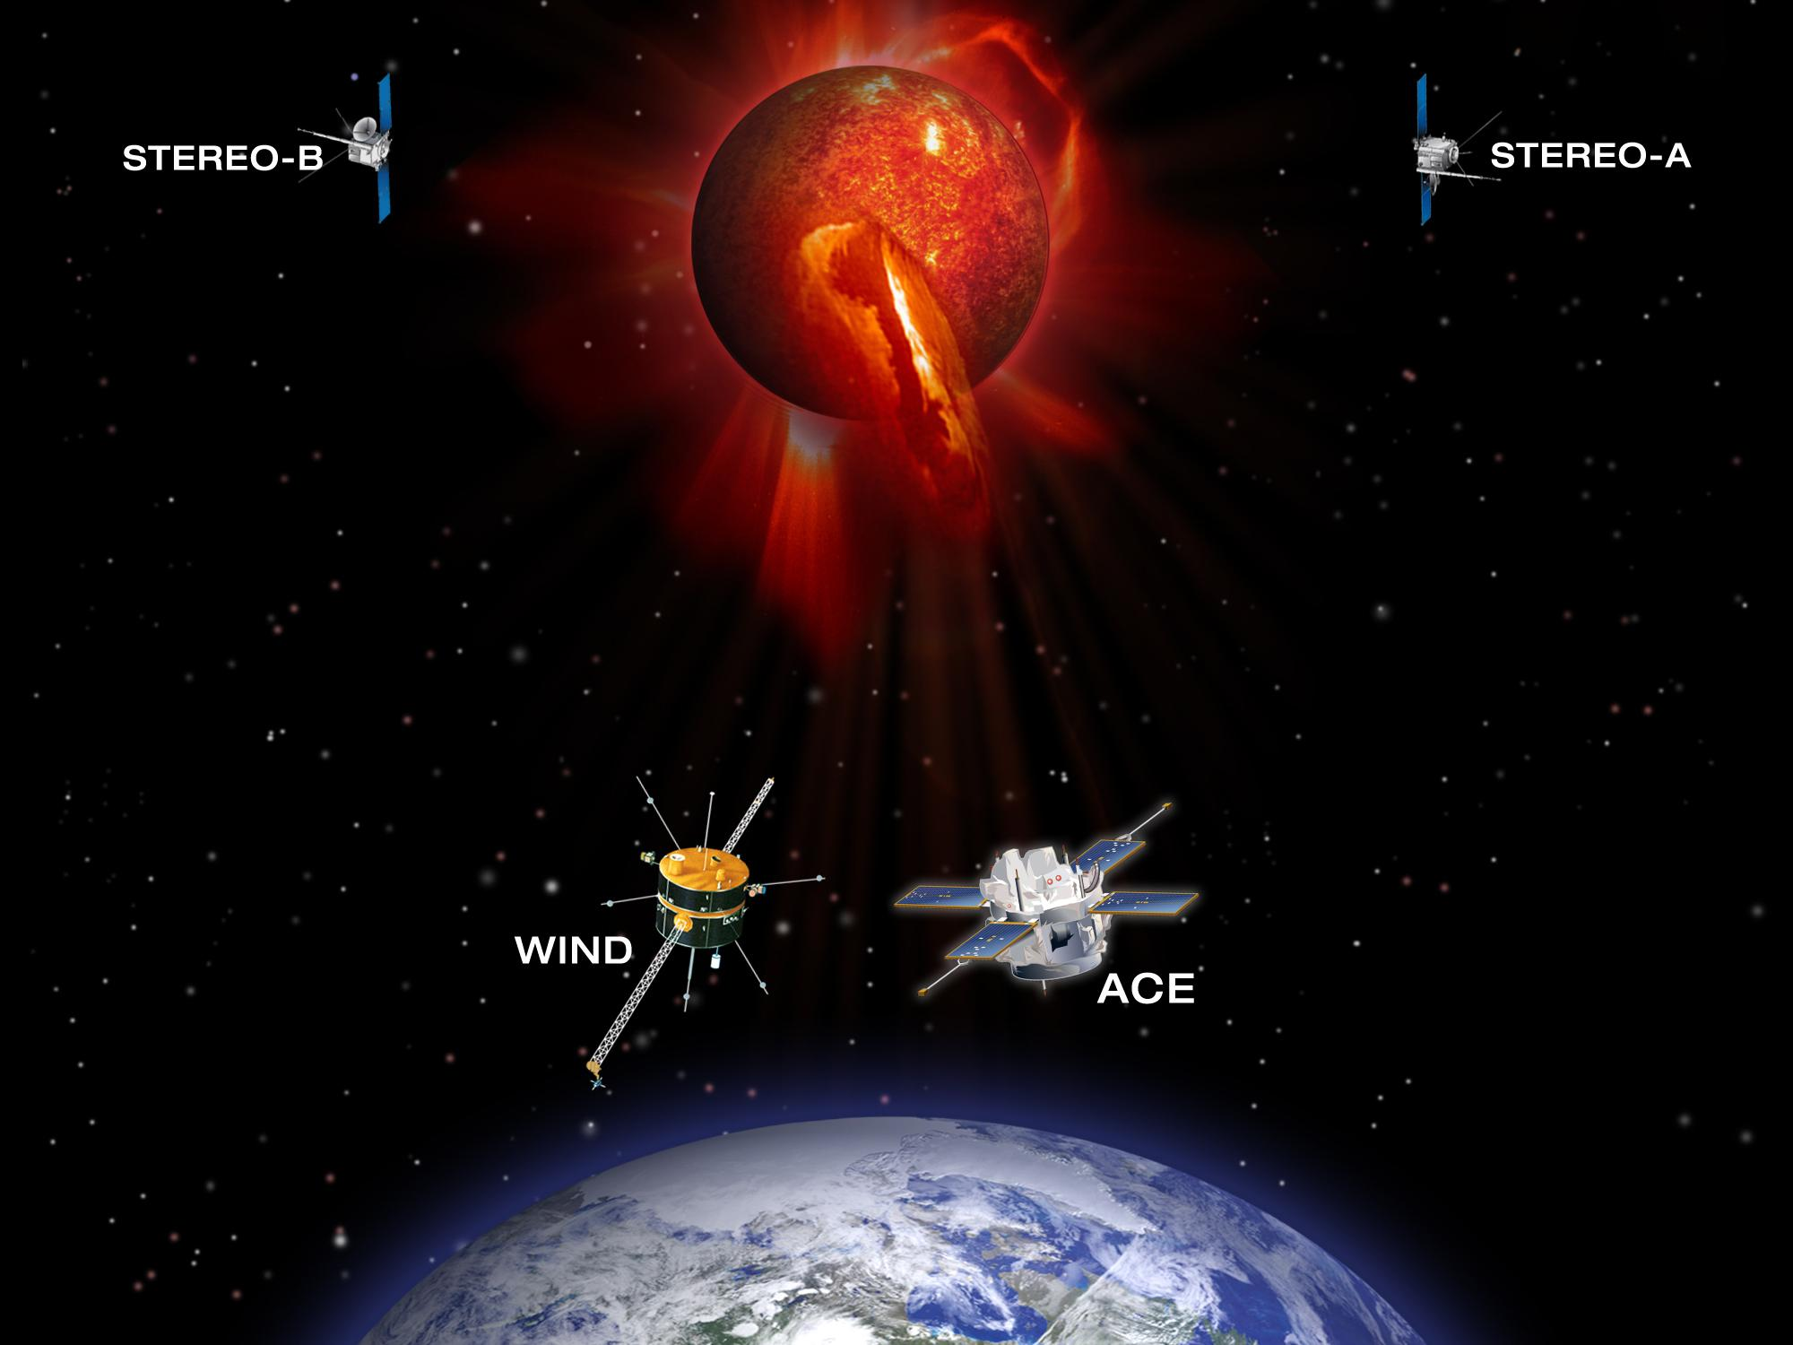
WIND Spacecraft
General purpose is to examine solar wind right before it reaches Earth
  as to understand how solar wind behavior affects the Earth’s atmosphere
Using antennas, the spacecraft measures the voltage of space plasma
Located near L1 Lagrange point, right in front of Earth and in parallel with the sun

Slide 4
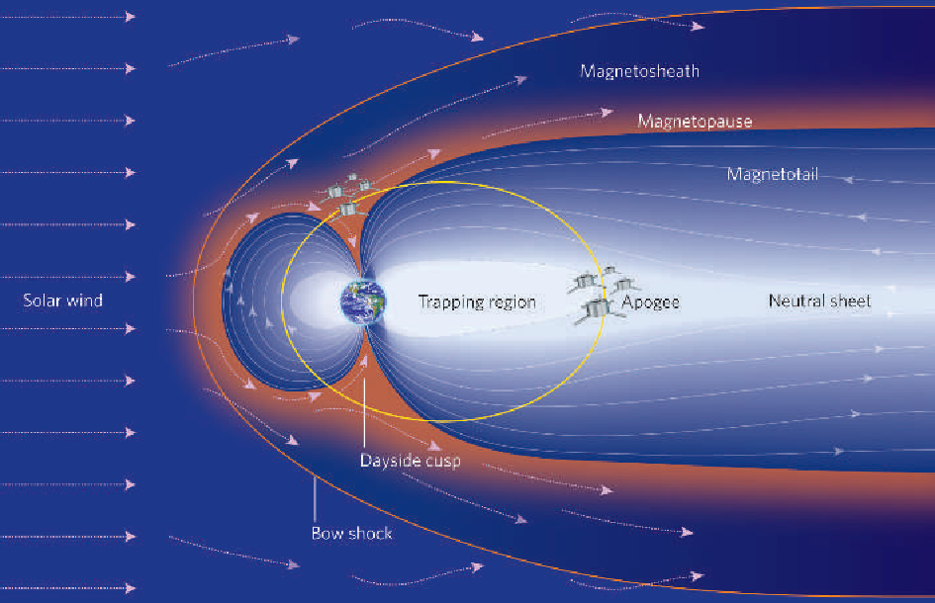
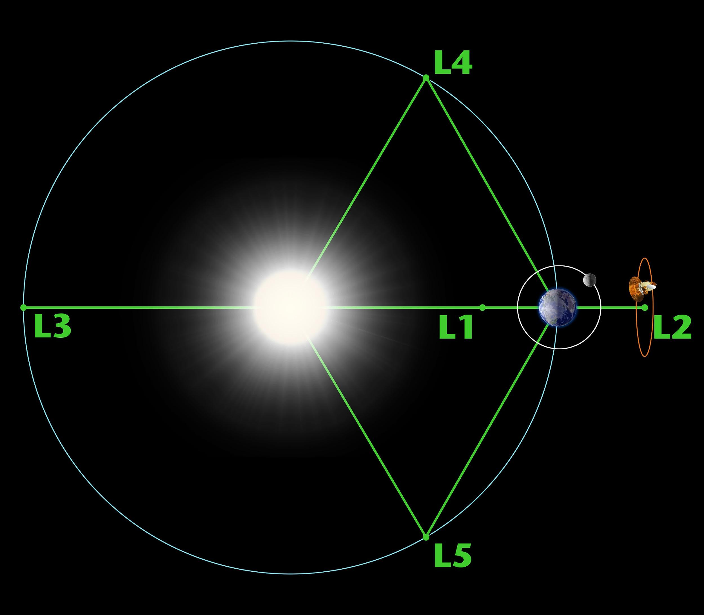

L1 Lagrange point
Result of interaction between solar wind (space plasm) and Earth’s Magnetosphere
Right around the Bow Shock
Think of it as solar wind hitting a wall of
that is Earth’s Magnetic field

Slide 5
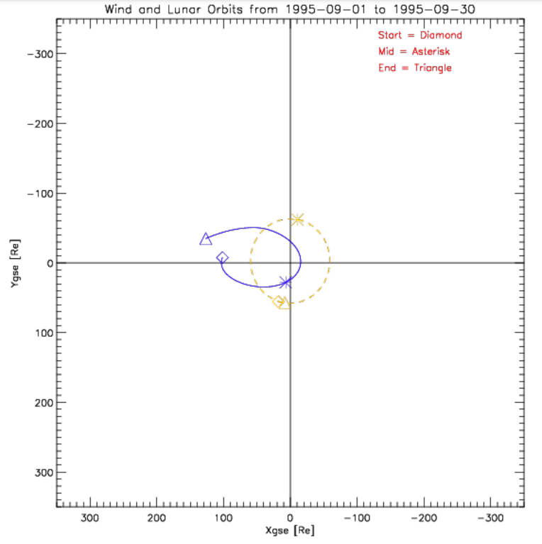
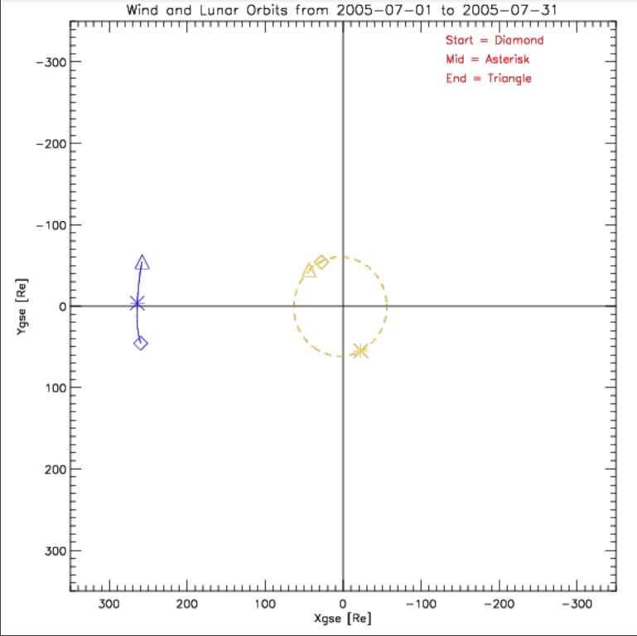
WIND Spacecraft’s Trajectory
Monthly orbits since 1994 up to 2004
  Went from Earth’s bow shock where solar wind from the sun is coming, up to behind Earth and back around
After 2004, it parks at and around the
L1 Lagrange point

Slide 6
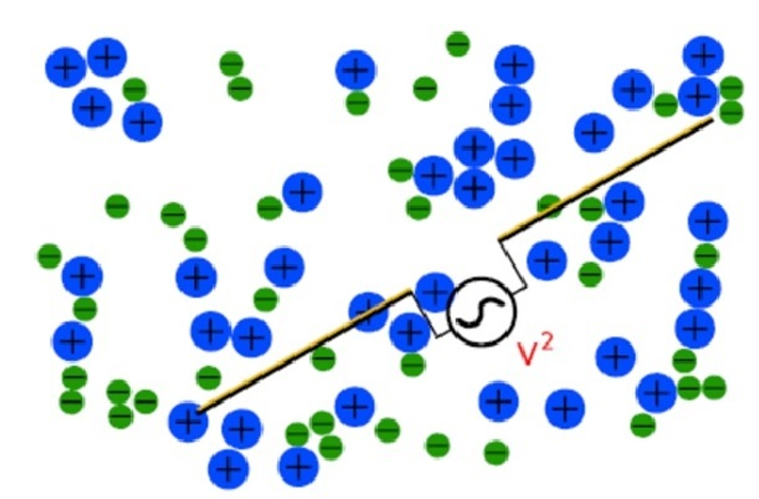
The Nature of Spectrum data
Using antenna measurements, we are able to capture electric field fluctuations in space plasma
  measure voltage on both ends of antenna and take the difference
  construct power spectrum
    Power in oscillations at certain frequency

Slide 7
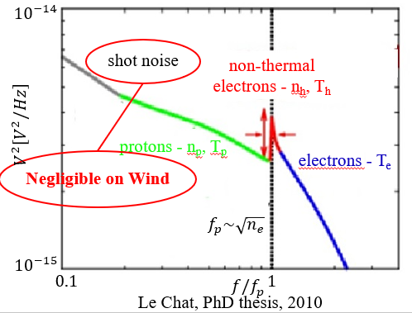
Quasi-thermal Noise Spectroscopy (QTN)
QTN is used to find electron density and electron temperature in space plasmas
The WIND Spacecraft dataset is vast and a great fit for this method
At the peak of the spectrum, there is electron resonance
    This frequency is directly proportional to square root of electron density

Slide 8
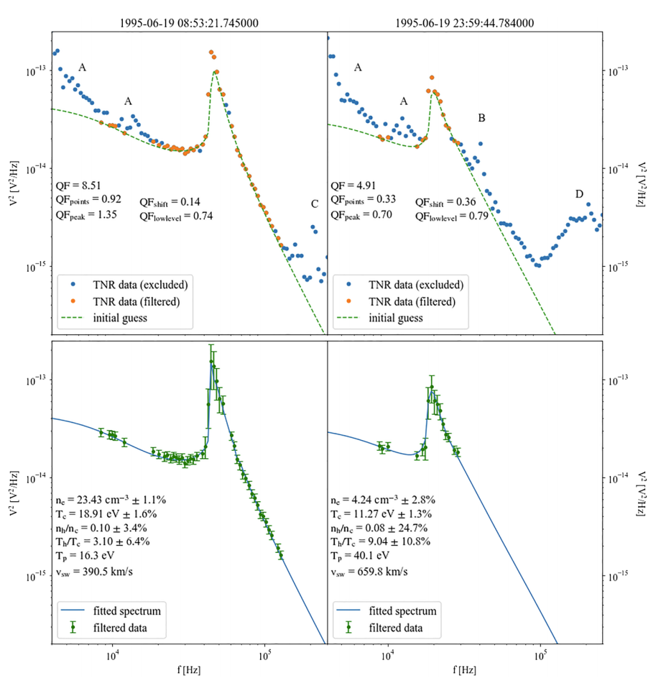
Framework For Data Analysis
We filter out from the spectrum:
A: proton noise modulation due to spacecraft spinning
B: 2nd harmonic of plasma frequency resonance
C: galactic radiation
D: Auroral kilometric radiation (AKR)

Slide 9
Framework For Data Analysis
We have python programs that utilizes QTN to process the WIND spacecraft data
Have set up an pipeline via UofArizona’s HPC services to analyze this data efficiently and accurately
Developed a scheduling script
  automates management of QTN data analysis submissions on HPC
  the data analysis is constantly ongoing
Volume of data
  200 million measurements
  Over 27 years
  Already processed about 4 million measurements

Slide 10
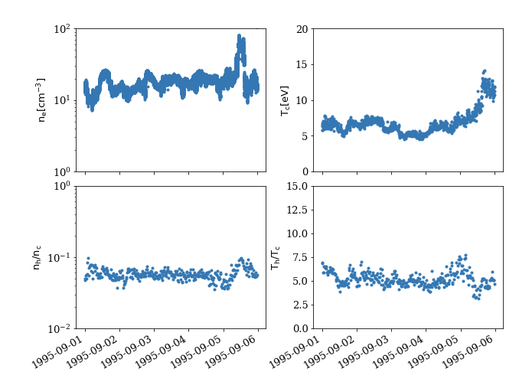
Sample Results
Analysis of first week of September 1995
Results are self consistent and physical trends are visible

Slide 11
Conclusion
We are able to correctly and efficiently analyze WIND spacecraft data via QTN
In the process of collecting a database of 27 years of analyzed data
  To be submitted to NASA
About 2% of the data is processed
  Is being processed quickly

Slide 12
Sources
Martinović, M. M., Klein, K. G., Gramze, S. R., Jain, H., Maksimović, M., Zaslavsky, A., et al. (2020). Solar wind electron parameters determination on Wind spacecraft using quasi‐thermal noise spectroscopy. Journal of Geophysical Research: Space Physics, 125., e2020JA028113. https:// doi.org/10.1029/2020JA028113
Martinovi ́c, M. M., A. Zaslavsky,M. Maksimovi ́c, and S. Šegan (2016),Electrostatic thermal noise in a weakly ionized collisional plasma,Radio Sci.,52, doi:10.1002/2016RS006189

